Slide 1


WHATSAPP TEXT EXTRACTOR AND TRANSLATOR
DELL Training, GSOP(Girl students outreach program)-2023
Yashaswini G R
1SI19CS143
CSE, SIT Tumkur

Slide 2

Problem Statement:
To access the whatsapp web message and fetch sender as well as receiver messages from the selected contact, then display it on the graphic user interface and translate those messages to desired language.

Slide 3
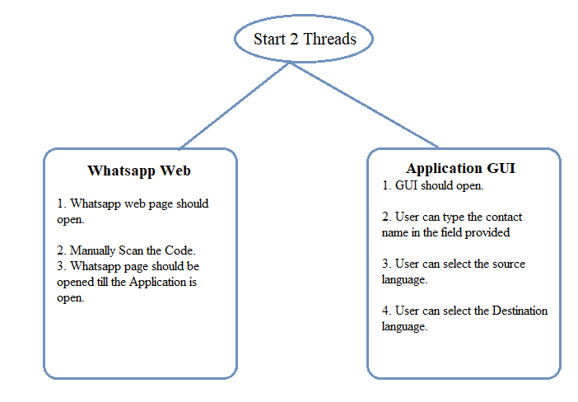
Approach Taken
Under the main function we create two functions for extracting message and displaying them. This is done with the help of threads.
Backend
Frontend

Slide 4
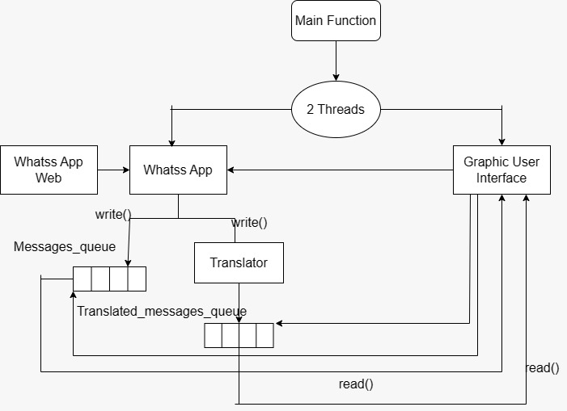
Architecture of the program

Slide 5
1.Selenium- Selenium is basically used for the automation of web browser 2. Multithread- Writing in queue and other which reads from queue and translating into other language 3.Queue- Inorder to store the message extracted from web 4.Tkinter- python package used for GUI 5.Playsound- Python package To convert text into speech 6.Speech_recognition- Python package to recognise the voice 7.googletrans – Python googletrans X==4.0.0 package is used to convert source language to destination language
Package and Modules
The packages and modules used in this project are:

Slide 6
Hardware and Software Requirements SOFTWARE REQUIREMENTS: 1)Operating system: Window 10 or higher 2)Visual studio code 3)Python IDLE 3.7.0 OR more HARDWARE REQUIREMENTS: 1)RAM:4.00GB or more 2)Input device: Keyboard and mouse 3)Output device: Laptop Display Screen

Slide 7
1. Enabling the access of the message by any other selected language along with English 2.Captioning the image that has been sent by using Deep Learning 3. We can design a separate web where people can access the real time translation
FUTURE IMPROVEMENTS :

Slide 8
Learning Outcome
Through this project I was able to learn
Application of Selenium Web Driver to automate WhatsApp (Use of chrome driver for navigation to WhatsApp web and take user input, inspecting an element on a webpage)
Building a Graphical user Interface using the Tkinter module in python, and integrating speech-to-text as well as text-to-speech modules.
Multithread concept in python to parallelly execute the WhatsApp function as well as display and translate function.

Slide 9
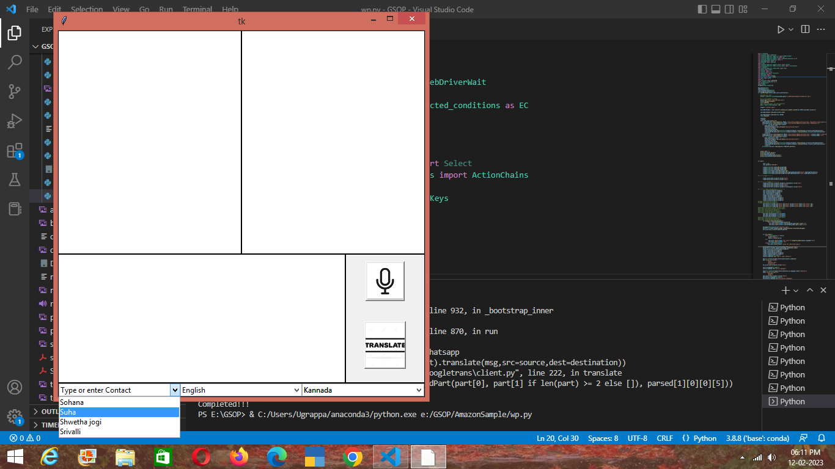
OUTPUT SNAPSHOT:

Slide 10
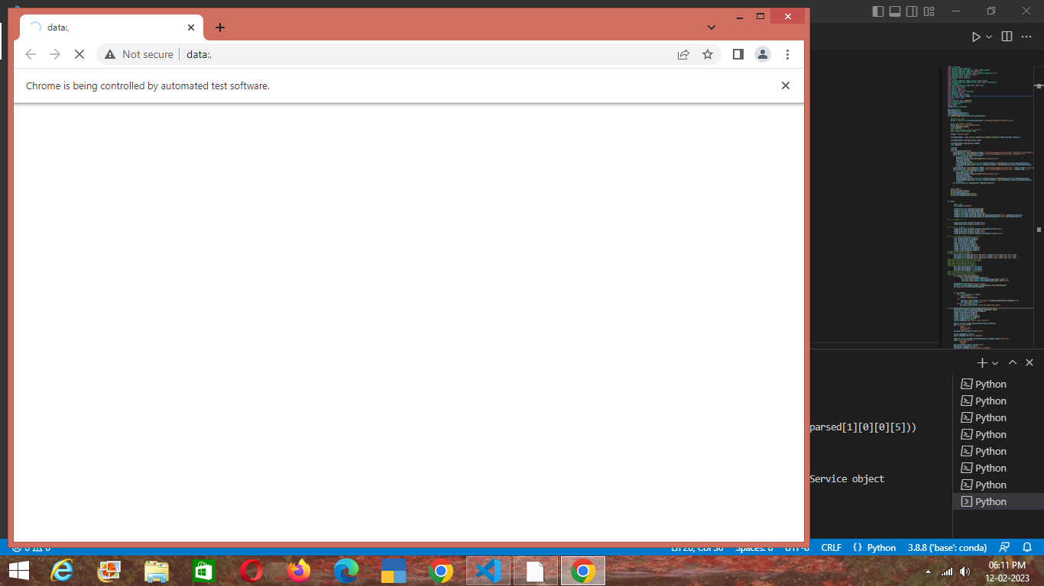

Slide 11
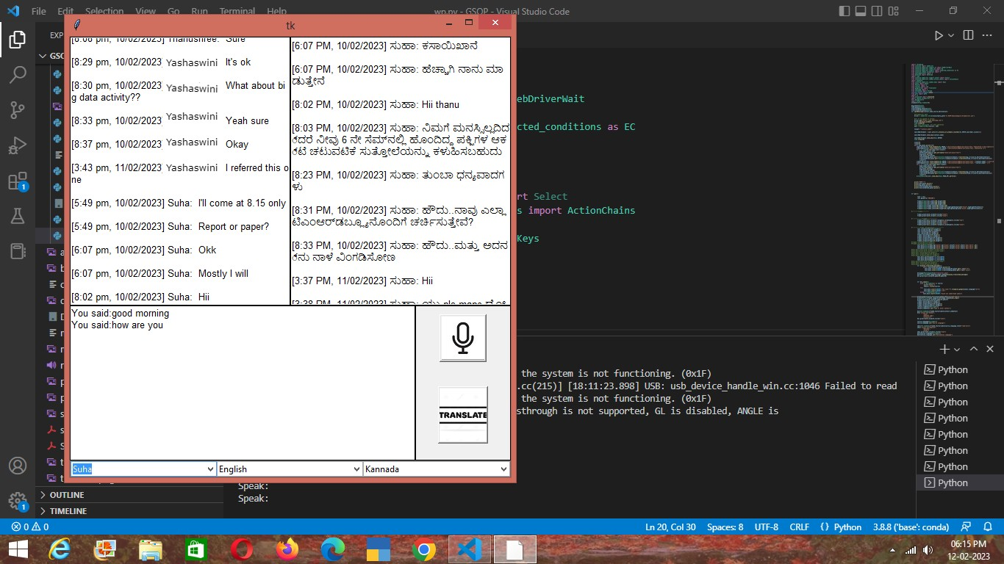
OUTPUT SNAPSHOTS:

Slide 12

Thank you!

